Slide 1
Viral Diseases

Slide 2
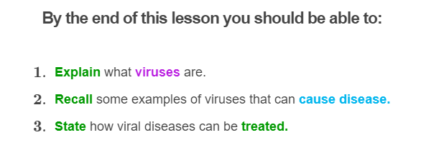
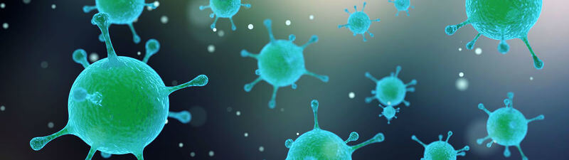

Slide 3
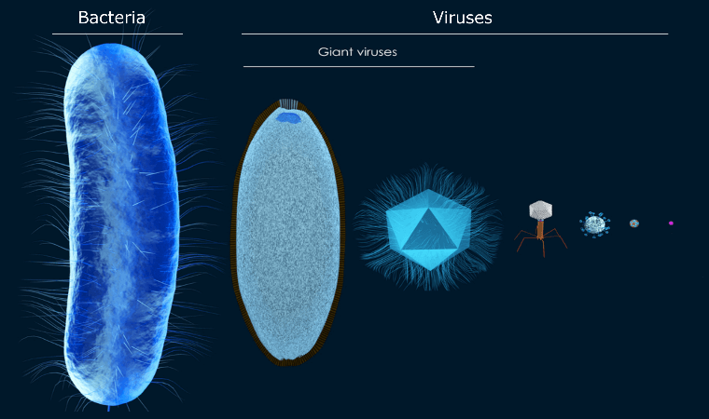
Viruses
Viruses are the simplest and tiniest of microbes. Some of the smallest viruses can be as much as 10,000 times smaller than bacteria!
A virus is a non-cellular pathogen (it is not made up of cells) that can only replicate inside the living cells of other organisms.

Slide 4
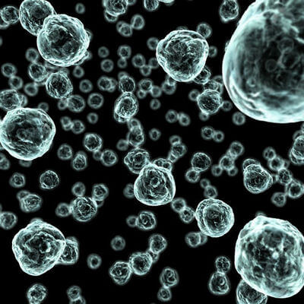
It has often been debated about whether viruses are living or non-living things.
On the one hand, if they're floating around in the air or sitting on a doorknob, they're inert. They're about as alive as a rock.
But if they come into contact with a suitable plant, animal or bacterial cell, they spring into action. They rapidly infect, replicate and take over the cell!

Slide 5
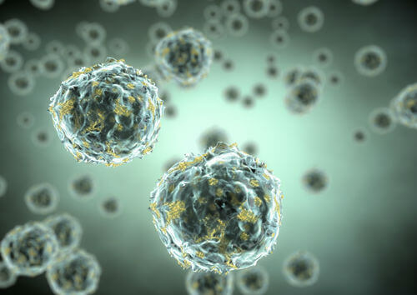
Viruses can only replicate when they infect a host cell.
They cannot reproduce on their own.
Viruses also do not digest or metabolise food into energy like living things do, which is why they are considered as non-living organisms.

Slide 6
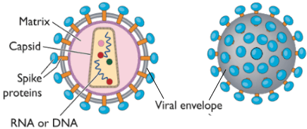
A virus typically consists of one or two strands of genetic material (DNA or RNA) surrounded by a protective protein layer called a capsid.
In some viruses, the capsid is covered by a viral envelope made of proteins, lipids and carbohydrates. The envelopes may be covered by spikes made of carbohydrates and proteins that help the virus particles attach to host cells.

Slide 7
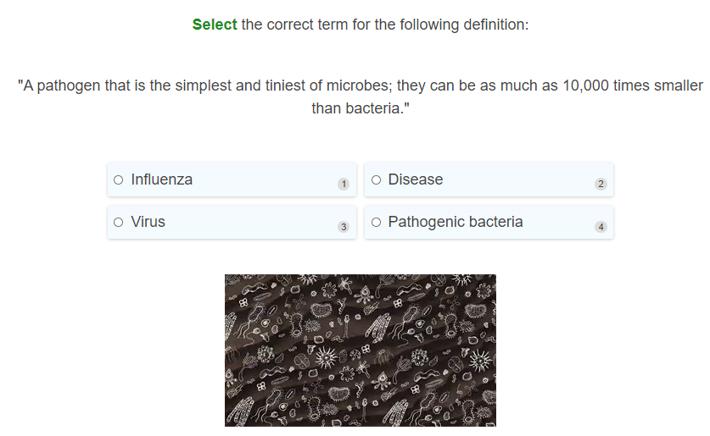

Slide 8
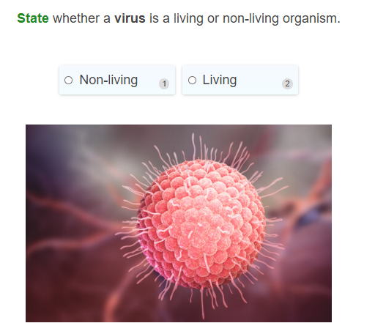

Slide 9
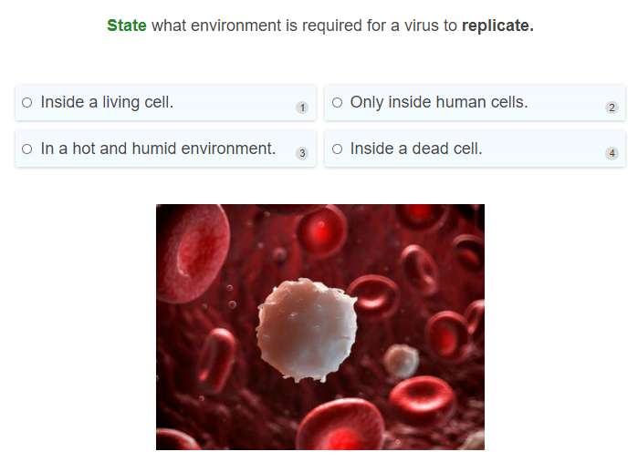

Slide 10
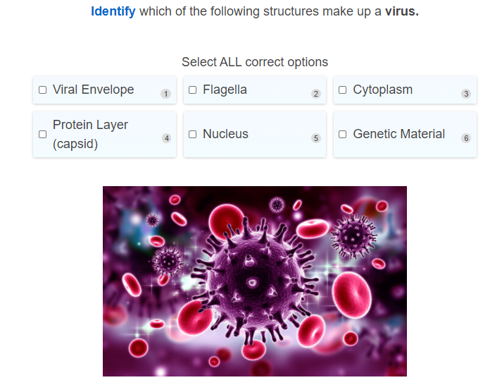

Slide 11
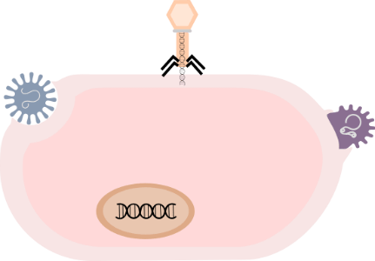
Viral Life Cycle I
A viral disease occurs when an organism's body is invaded by pathogenic viruses.
Viruses can only replicate by entering cells of a living host and taking over the reproductive machinery of suitable host cells.
1. To begin, infectious virus particles attach to and enter the cells of the body. When viruses want to attack a living host or cell, they use a very specific protein on the outer surface of its capsid or envelope that will allow its attachment to the surface of the host cell.

Slide 12
Viral Life Cycle II
2. After attaching to an appropriate host cell, the virus will get its genetic material inside the cell. It can do so in a variety of different ways, depending on the type of virus it is.
These include either:
Injecting their genetic material inside the host cell.
Tricking the host cell to pull it inside.
Fusing its viral envelope with the host cell wall or membrane to get inside the cell

Slide 13
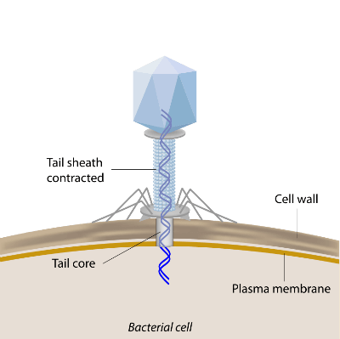
Viral Life Cycle III
3. Once the virus has entered the host cell, viruses will release its genetic material inside, allowing it to take over the host cell machinery.
The virus will shut down production of host proteins and direct the host cell to produce viral proteins to make new virus particles.
This process is called replication, where the virus uses the host to copy its own genome and makes lots of copies of itself!

Slide 14
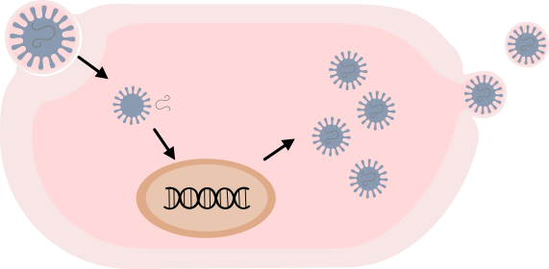
Viral Life Cycle IV
4. After replicating itself, the virus then assembles all the viral proteins together resulting in lots of identical copies of the original virus!
These newly assembled infectious viruses can then be released through budding out, or when the host cell bursts.
This results in the viruses to go out and infect other host cells, continuing to cause disease in the host.

Slide 15
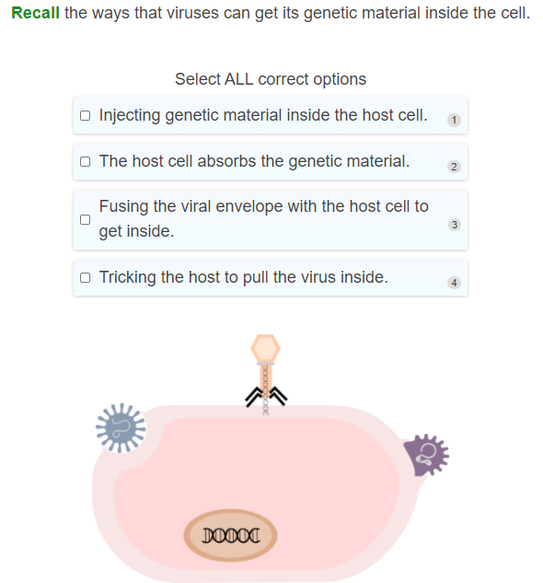

Slide 16
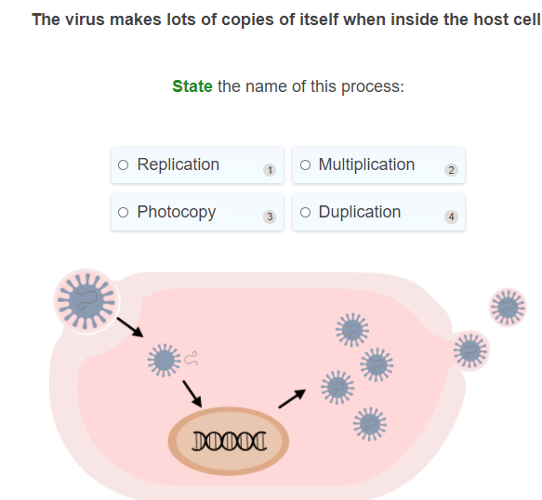

Slide 17
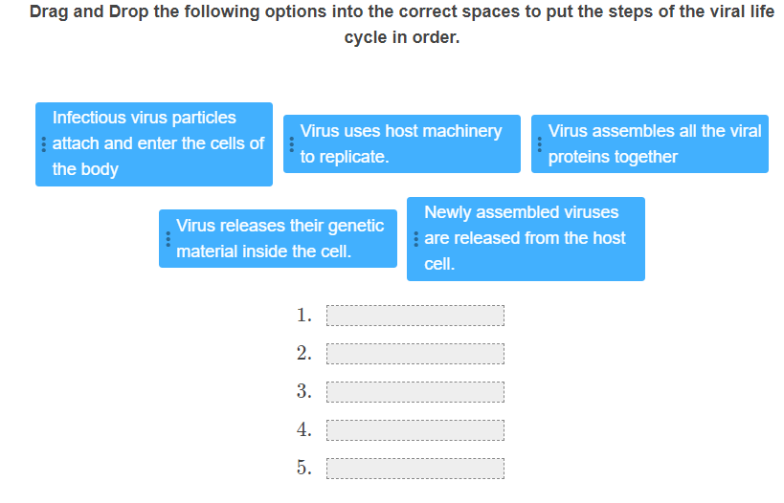

Slide 18
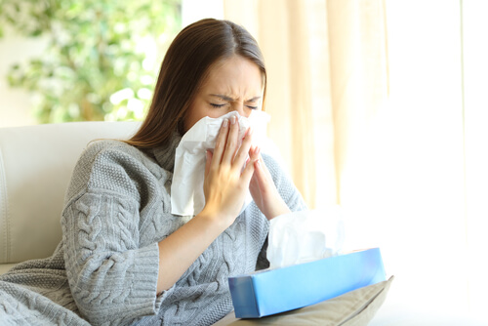
Examples of Viral Diseases: Common Cold
Viruses can cause nasty diseases in people! One of the most common type of viral disease that you will probably have experienced before is the common cold.
The common cold is generally caused by the rhinovirus and affects the respiratory tract. This virus results in viral infection of the upper respiratory tract (nose and throat).
The common cold usually results in mild symptoms like a runny or a stuffy nose, sneezing, and a cough. You usually do not get a fever with the cold. If you do then you may actually have the flu not a cold!

Slide 19

Examples of Viral Diseases: Influenza
Influenza is the virus that causes the flu! Like the viruses that cause the common cold, the flu also infects the respiratory tract.
Although the symptoms of the flu can seem similar to the cold, symptoms are usually more severe. It can result in a sore throat, runny nose, fever, chills, a loss of appetite and a dry cough.
Influenza is also very contagious and often spread when droplets containing the virus are inhaled by other people.

Slide 20
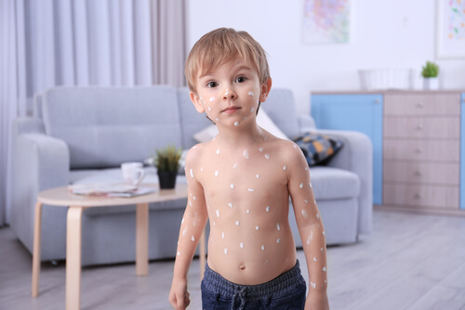
Example of Viral Diseases: Chickenpox
Chickenpox is characterised by a skin rash that becomes itchy, and it is highly contagious. It is caused by the varicella-zoster virus (VZV).
Most cases of chickenpox occur in children before they are 10 years old and once a person has had the virus it is unlikely that they will get infected from it again.
Chickenpox usually begins as itchy red blisters that can occur all over the body and can clear up within one to three weeks but can leave scars. It is important to not scratch to avoid getting scars and infected blisters!

Slide 21
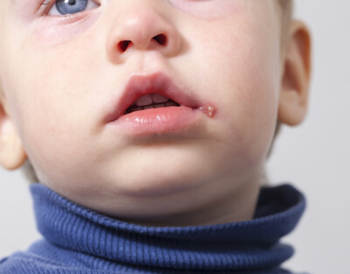
Example of Viral Diseases: Cold Sores
Cold sores are small blisters that usually appear around the lips and mouth, and are caused by the herpes simplex virus.
This virus is very contagious and can be spread to other people through close direct contact.
After contracting the virus, it can take a while for symptoms to appear as the virus can remain inactive for a long period of time. However, certain stresses can activate the virus causing the development of the cold sore.

Slide 22

Treatment of Viral Diseases
Viral infections are usually left to the immune system to deal with and no particular medication is given. Antibiotics do not help treat viral infections - they only work for bacterial diseases.
Most of the time for viral infections the treatments given can only help you to deal with symptoms, while you wait for your immune system to fight off the virus.
In some cases anti-viral drugs may be given. Anti-viral drugs can target viruses and stop the virus from multiplying and spreading throughout the body or can destroy the virus so that your immune system can more effectively fight the viral invader.

Slide 23
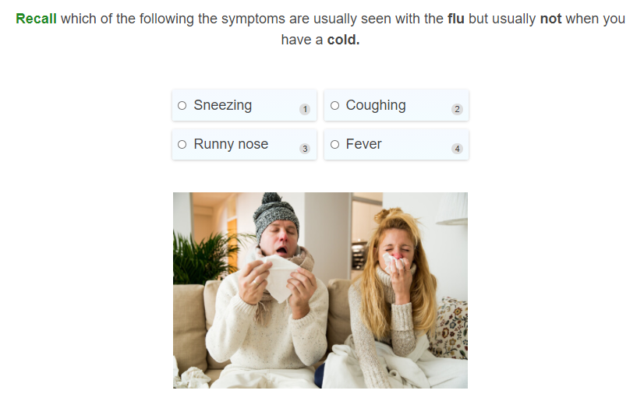

Slide 24
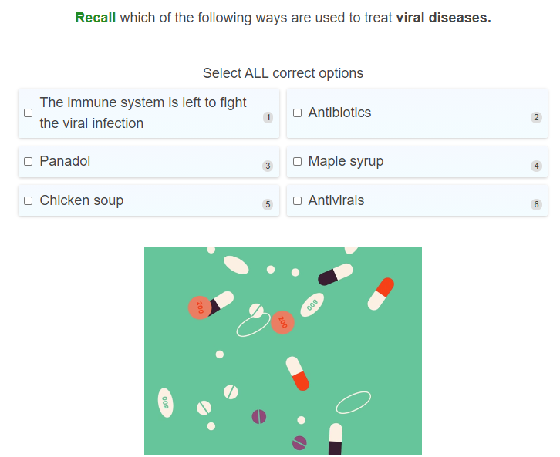

Slide 25
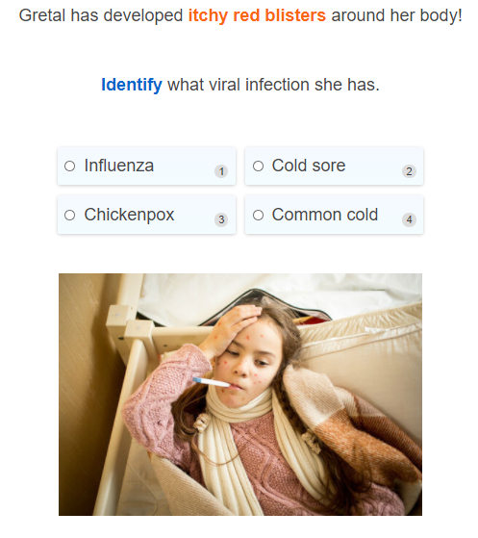

Slide 26
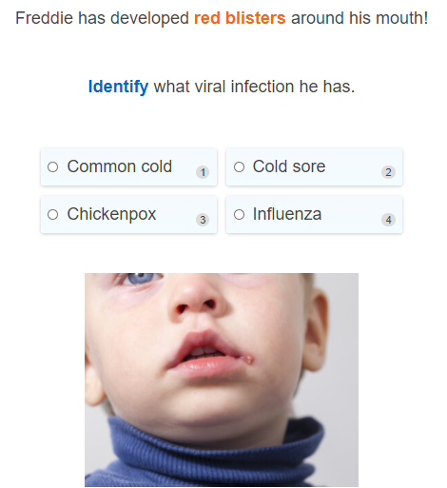

Slide 27
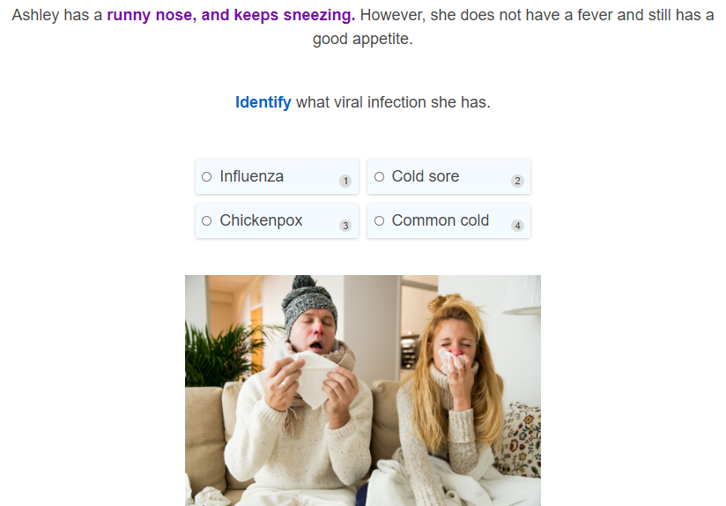

Slide 28
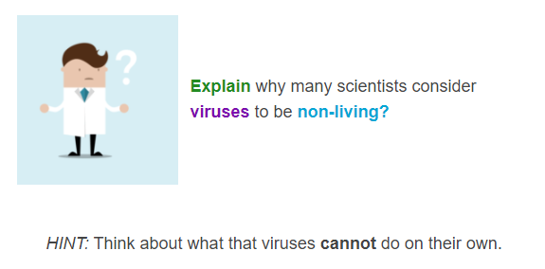

Slide 29
